Slide 1






Practical teaching of data science: the role of challenges Isabelle Guyon
Chaire Informatique: Donnée Massives

Slide 2
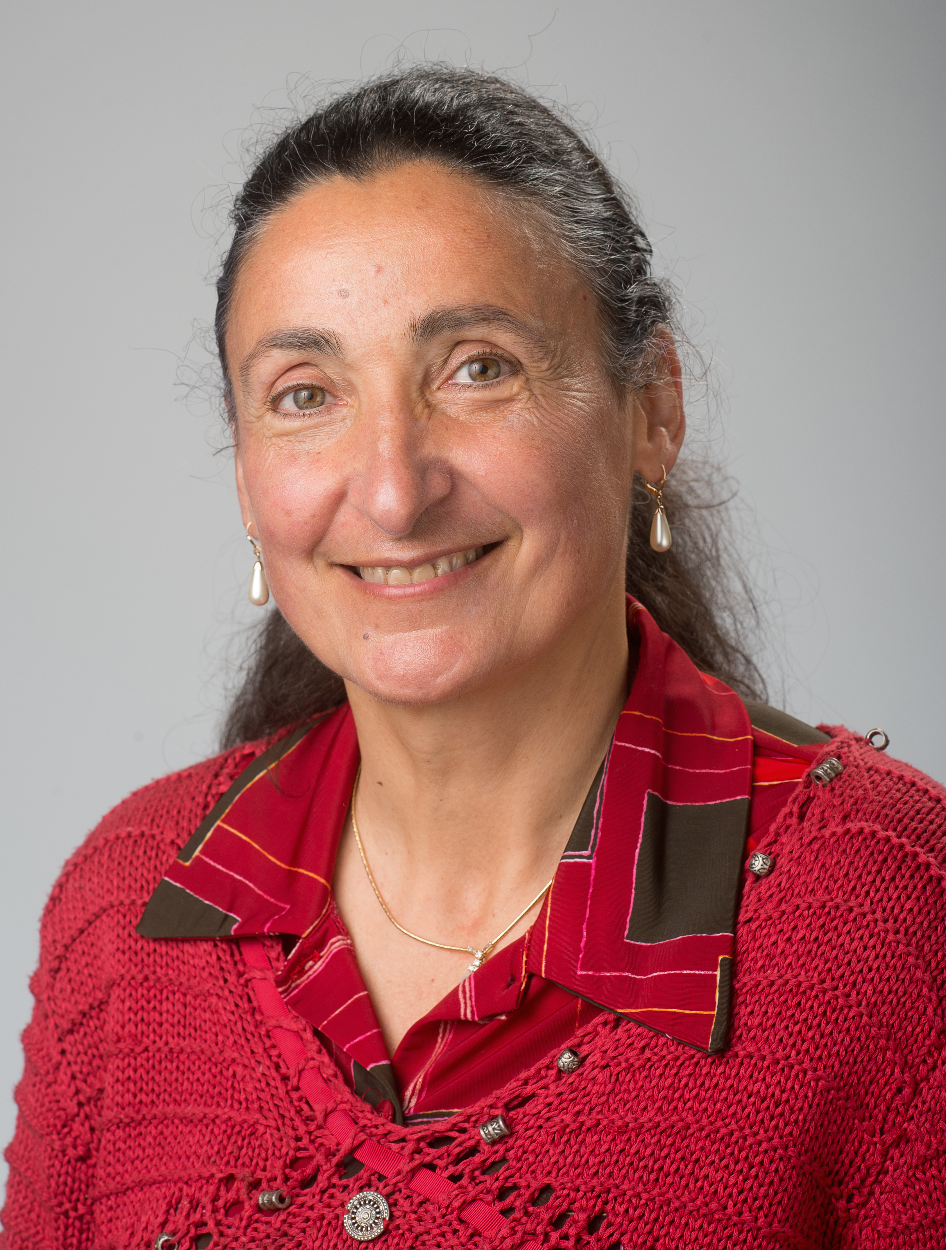
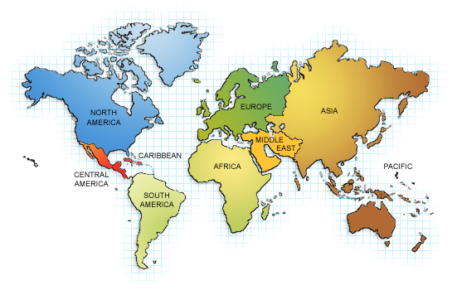




Itinerary:

Slide 3
Thanks:
TAO/ LRI colleagues:
Michele Sebag and Marc Schoenauer
Cécile Germain
Balázs Kégl
Other LRI professor colleagues:
Alain Denise
Christine Paulin
Master and license professors:
Guillaume Wisniewski (LIMSI, L2 informatique)
Alexandre Allauzen (LIMSI, M2 AIC)

Slide 4





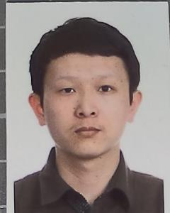
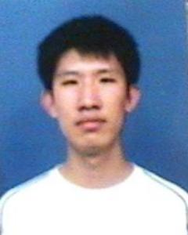





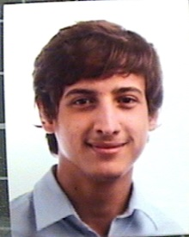
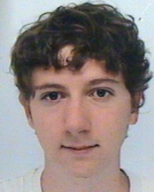







One hundred students (1/3 M2, 2/3 L2):

Slide 5

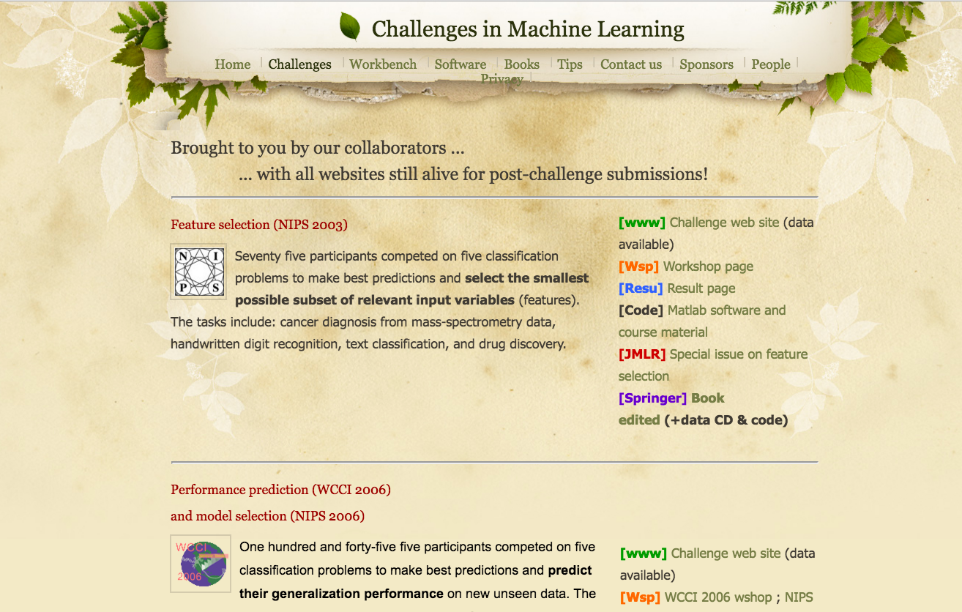
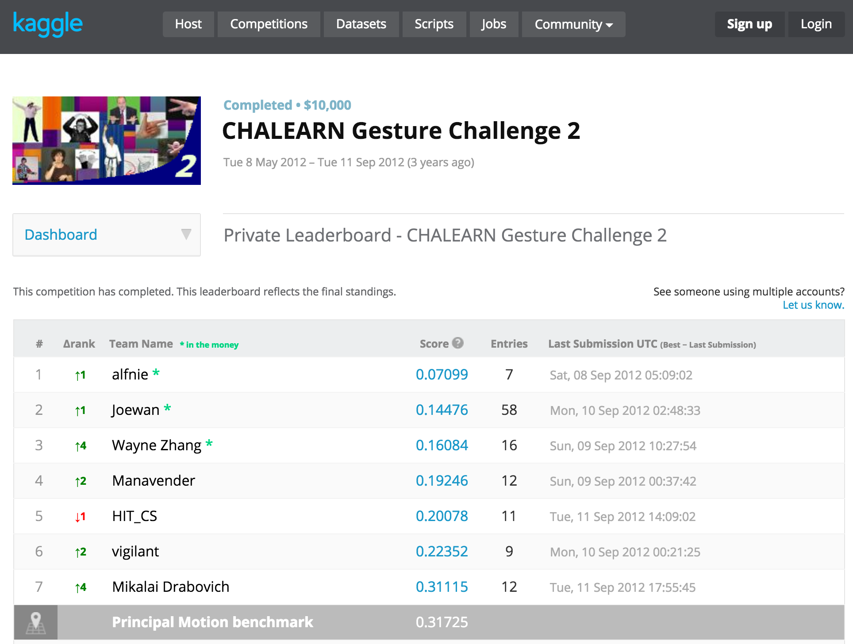
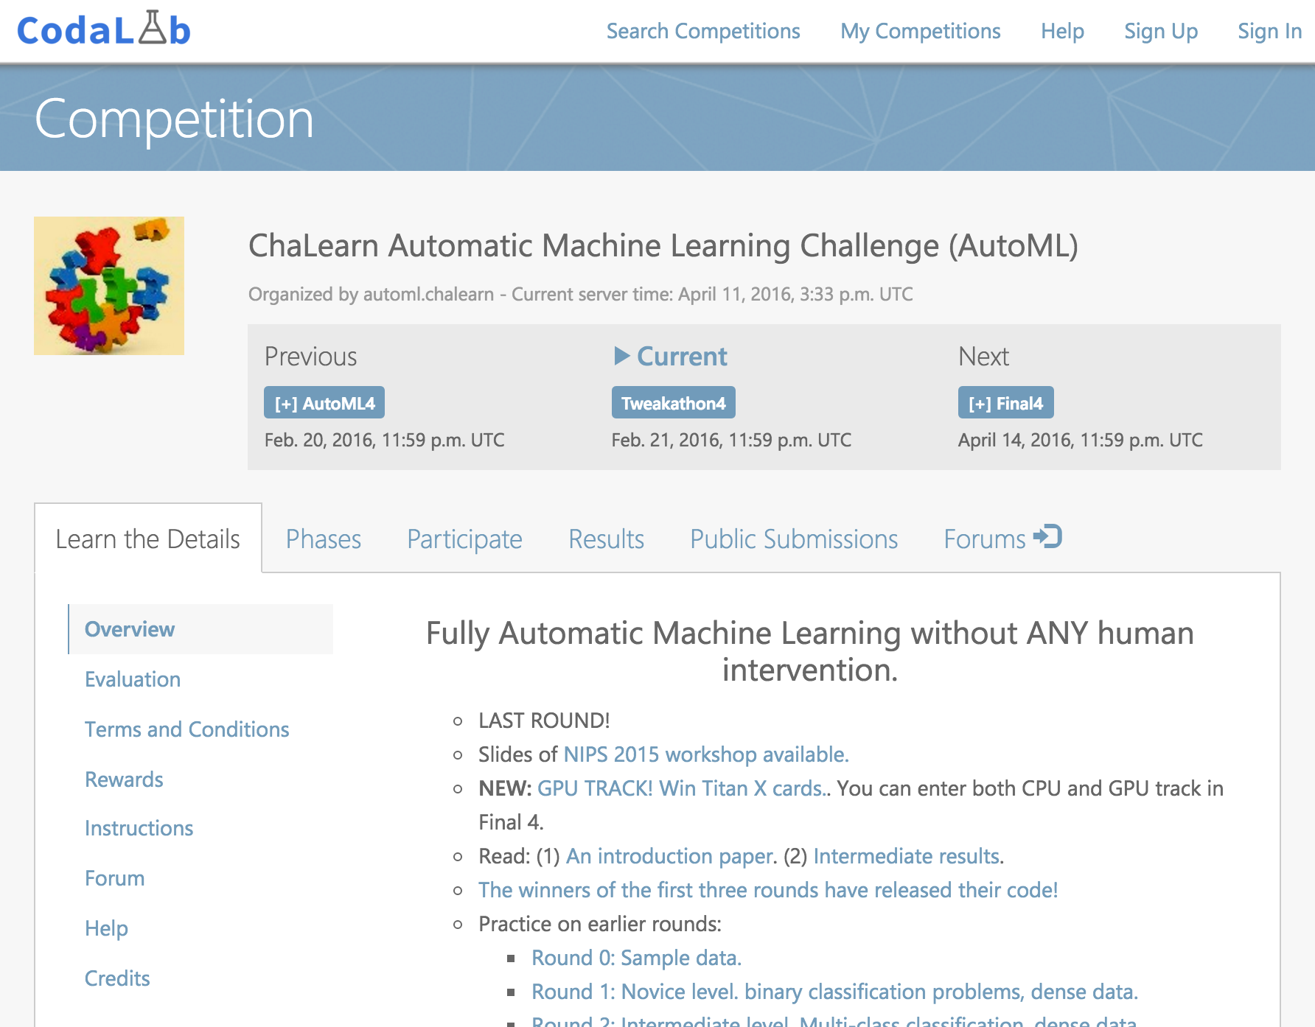
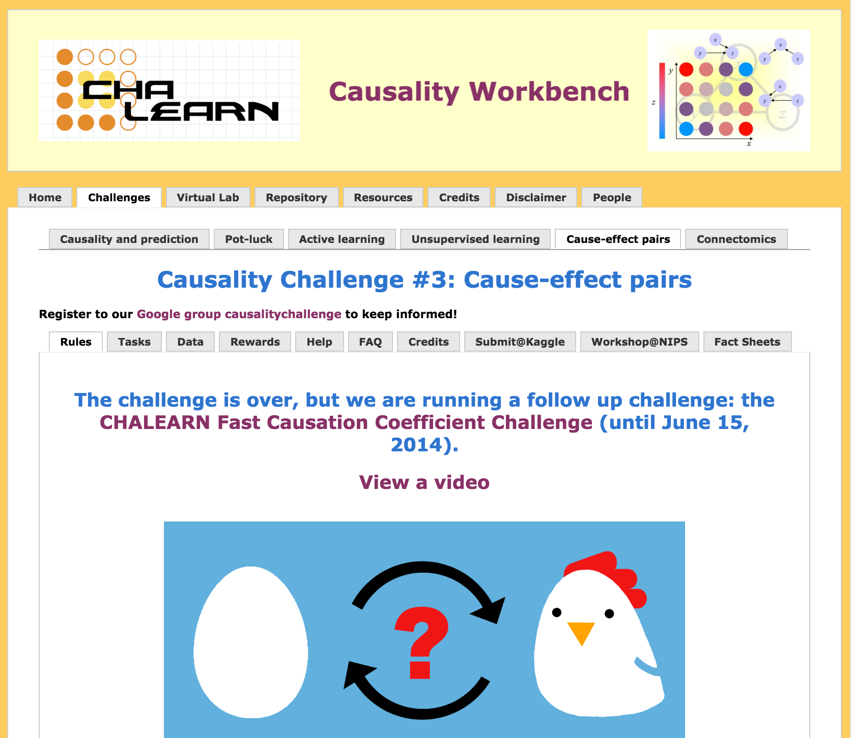
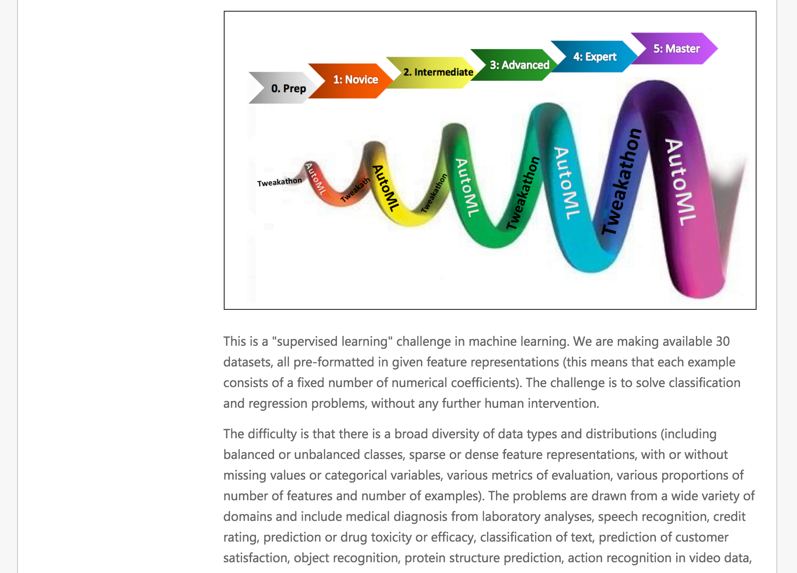
http://chalearn.org

Slide 6
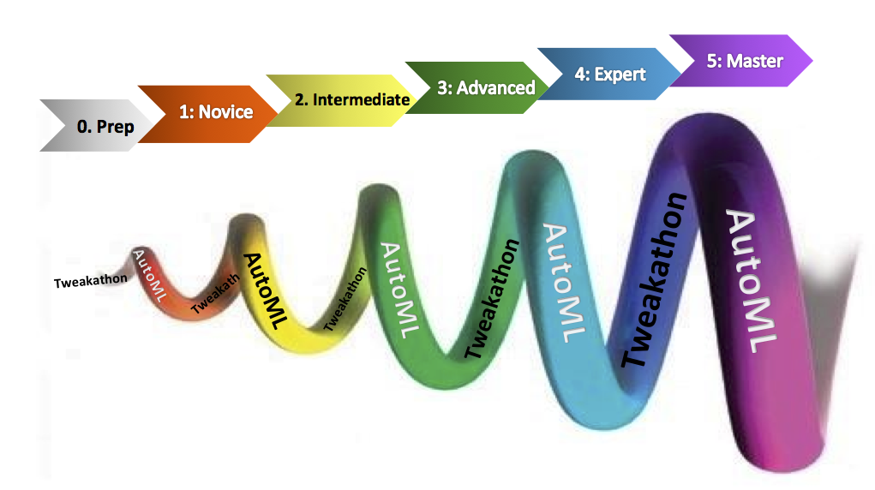

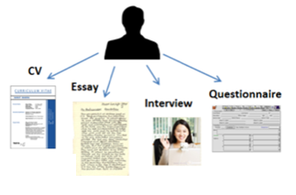
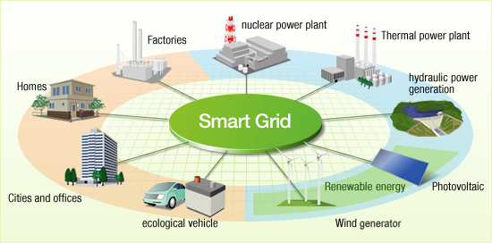
Challenges in research:
HEPML Physique des
hautes énergies
(with Balazs Kegl et
Cécile Germain, LRI)
AutoML (with Balazs Kegl
et Cécile Germain, LRI)
Homo Numericus
Recommandations d’emploi
(with Michèle Sebag, LRI)
RTE Réseau électrique
(with Olivier Teytaud, LRI
et Patrick Panciatici, RTE)

Slide 7

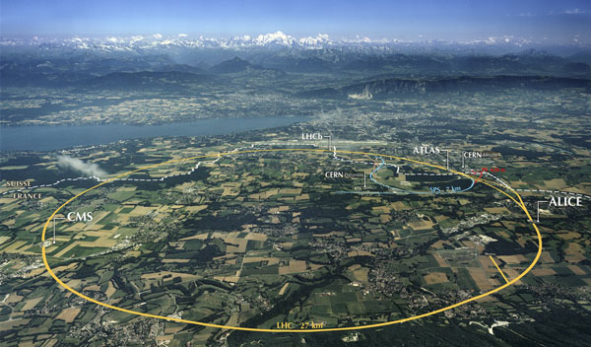

High Energy Physics:
Higgs ML challenge (2014)
with Cecile Germain, David Rousseau and Balazs Kegl
Track ML in preparation
Large hadron Collider (27 km de circonference)

Slide 8



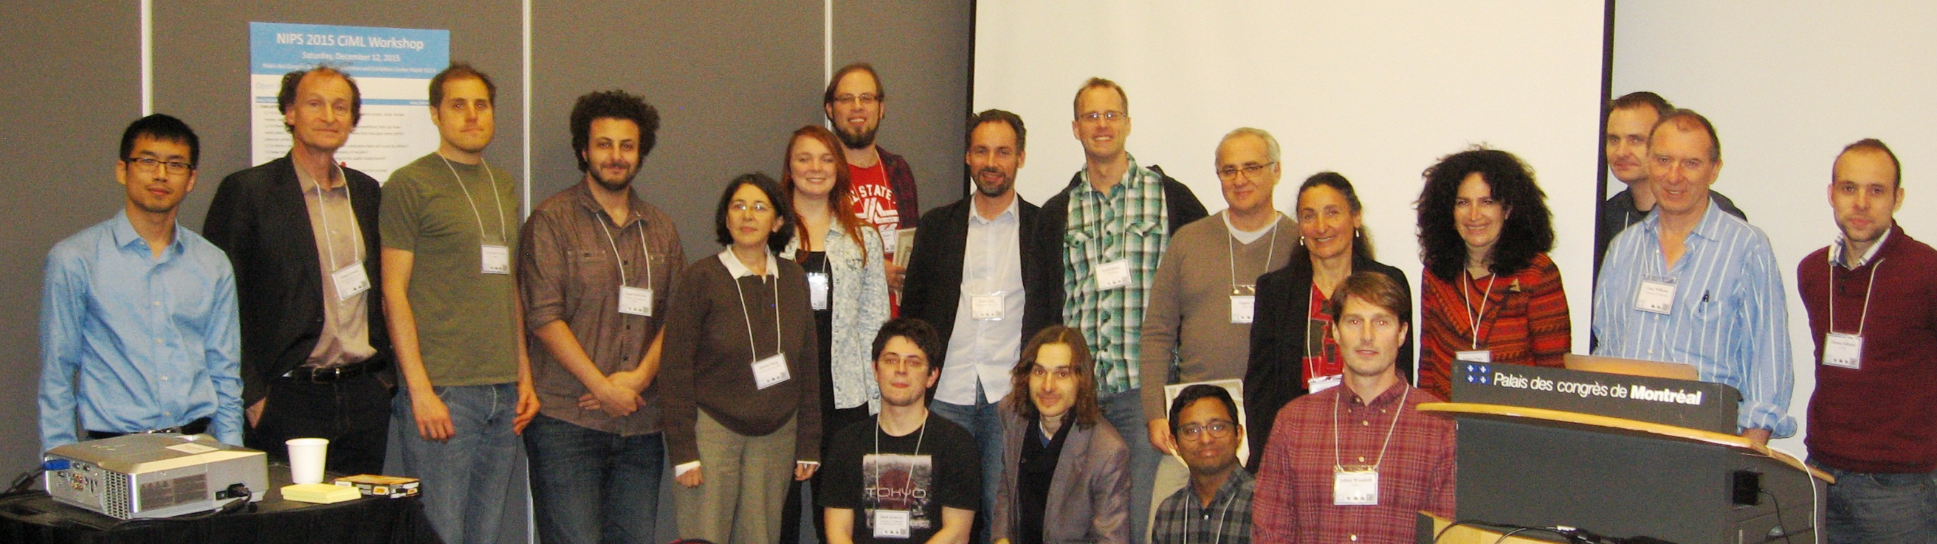









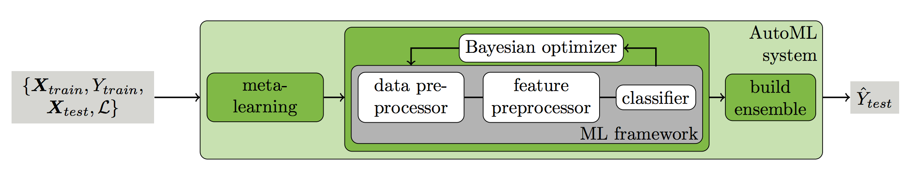
AutoML challenge:
IJCNN 2015
Collaborators include: Michele Sebag, Cecile Germain, and Balazs Kegl
Methods for Improving Bayesian Optimization for AutoML
Matthias Feurer, Aaron Klein, Katharina Eggensperger, Jost Tobias,
Manuel Blum, Frank Hutter, ICML workshop on AutoML, 2015.

Slide 9

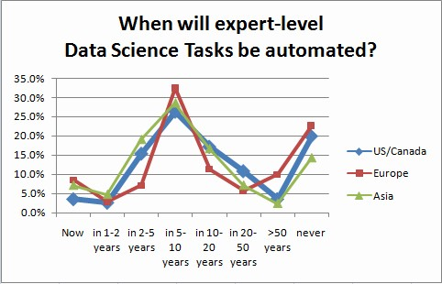
When will AutoML happen?
Data Scientist has been called the sexiest job of the 21st century.
But perhaps the century will last only 25 years.
Gregory Piatetsky
http://www.kdnuggets.com/2015/05/data-scientists-automated-2025.html

Slide 10

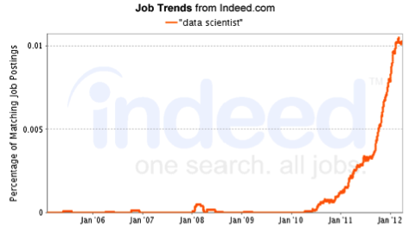
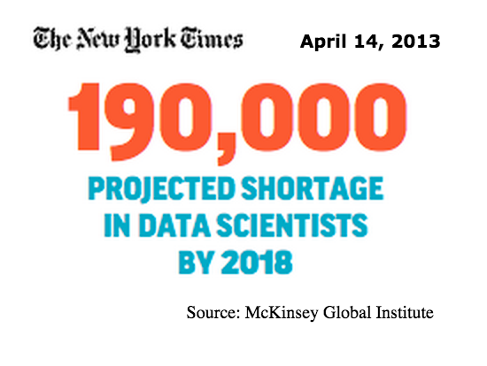
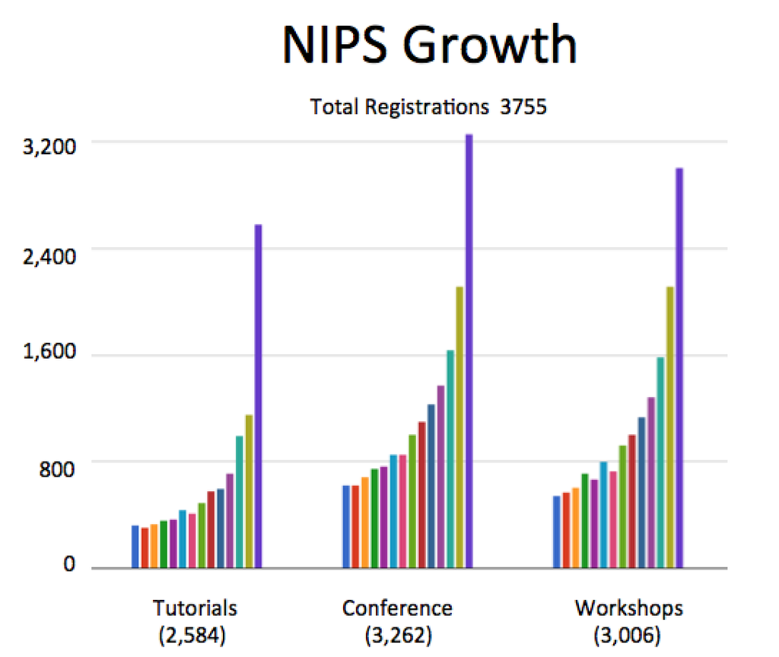
Harvard Business Review, 2012
https://hbr.org/2012/10/data-scientist-the-sexiest-job-of-the-21st-century/

Slide 11

Challenges = crowdsourcing data science
Trained
model
Crowd
TRAINING
DATA
Answer y
?
Query x

Slide 12
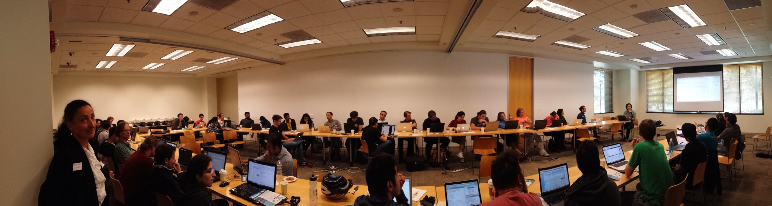
Introduce challenges in teaching:
Paris / Lille / Petersburg / Stanford, 2015/2016
Hackathons/bootcamps/RAMP ~50 to 80 participants each.
Invited speakers/tutorials (python/scikit-learn/GPU)
Code sharing: “coopetition”.
AN NOW: 60 L2 students in mini-projects.

Slide 13

Teaching challenge organization:
Hard: solving data science problems.
Harder: formulating data science problems.

Slide 14

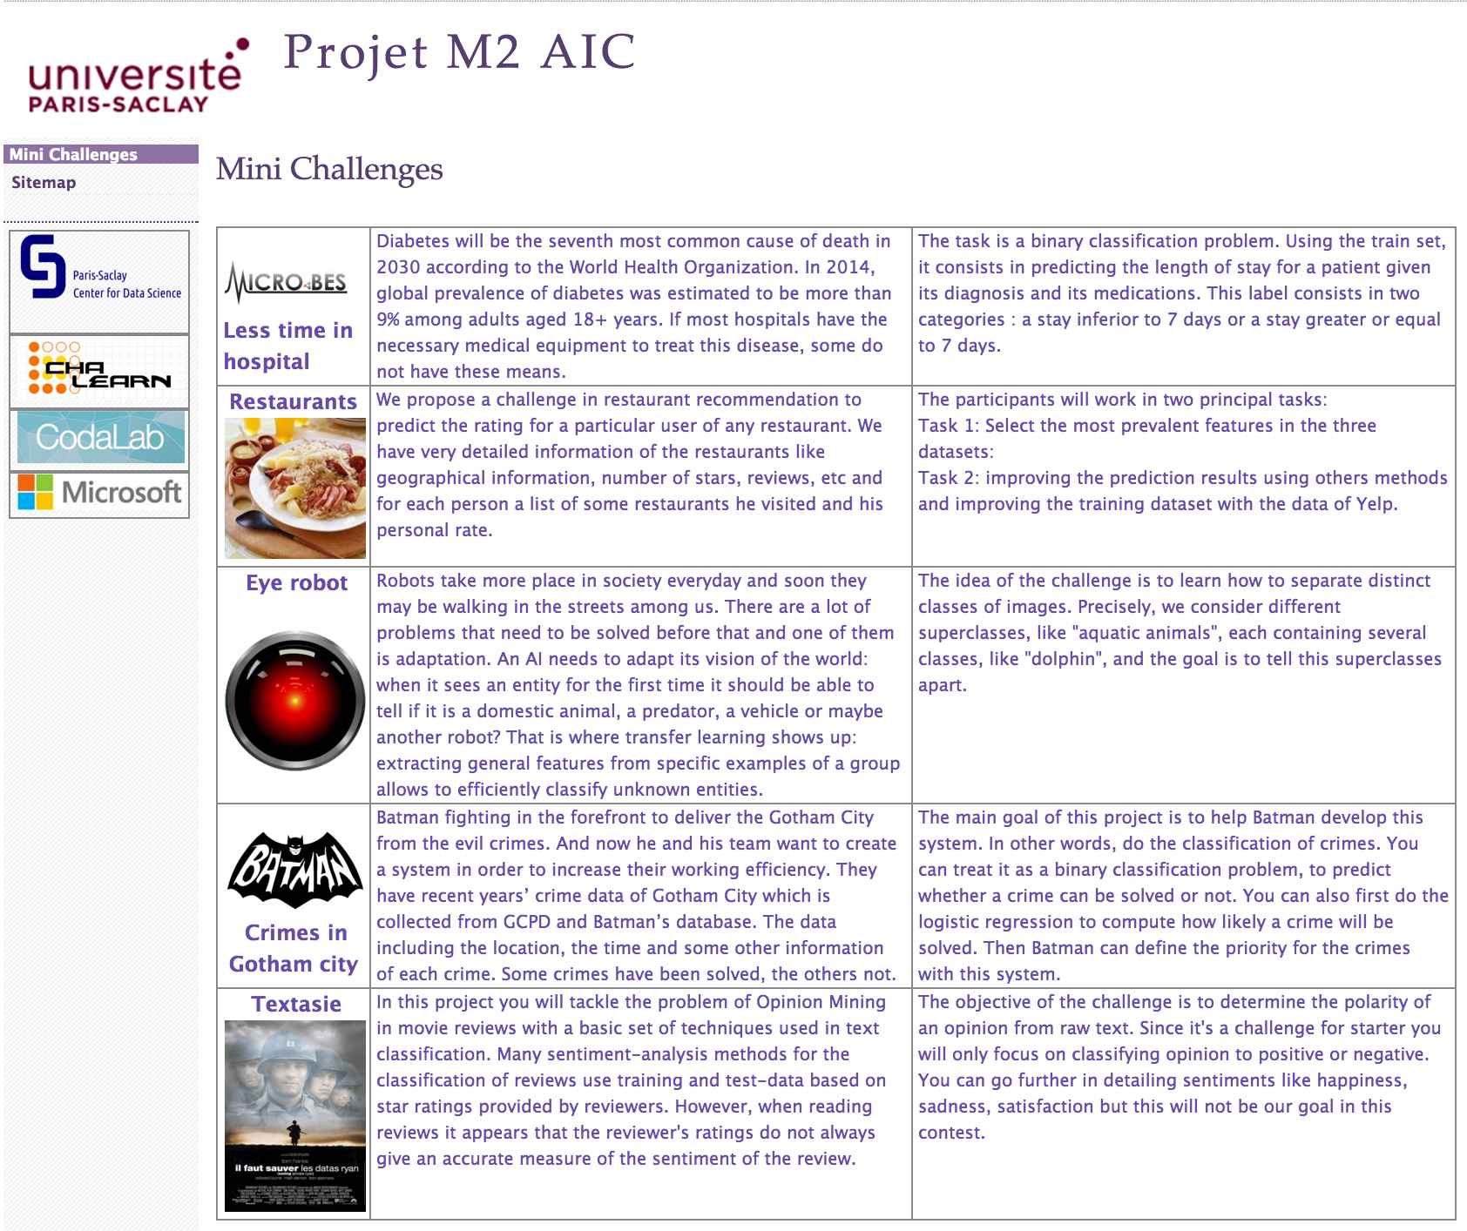
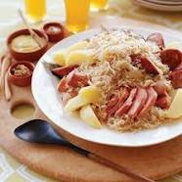



Master student project:
https://sites.google.com/a/chalearn.org/saclay/

Slide 15
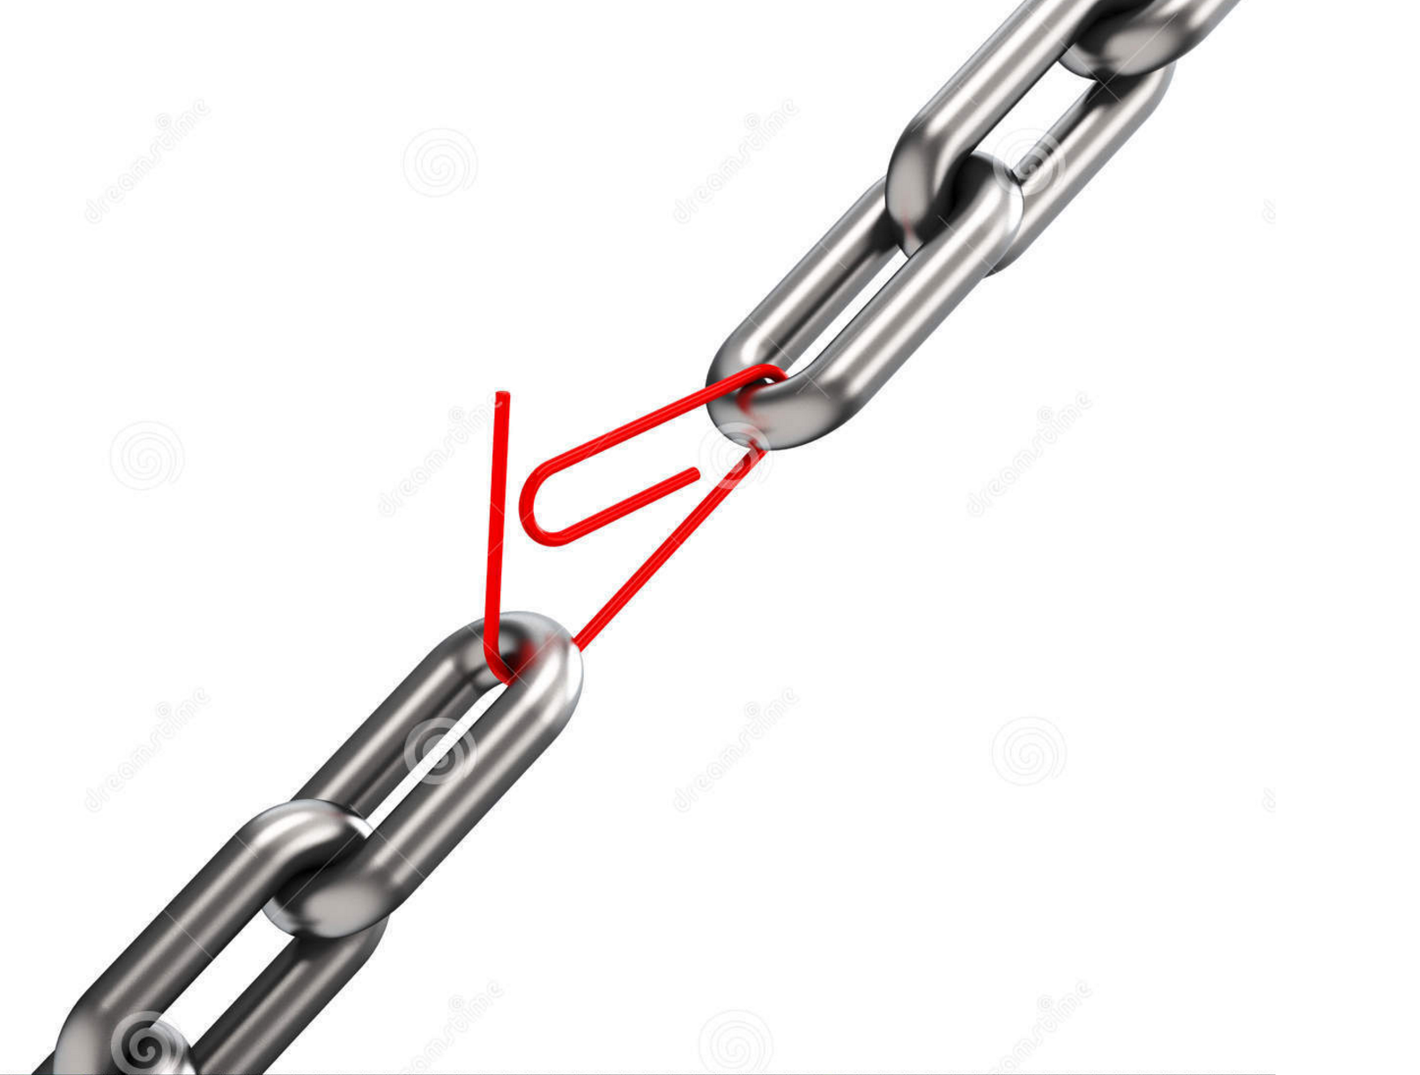
a chain is not stronger than its weakest link
Data
Metrics
Protocol
Baseline
Doc
Rules
Platform
Task
Publicity
Testing

Slide 16


Data collection and formatting:
Data
Metrics
Protocol
Baseline
Doc
Rules
Platform
Task
Publicity
Testing

Slide 17
Data collection and formatting:
DATA
Data
Metrics
Protocol
Baseline
Doc
Rules
Platform
Task
Publicity
Testing

Slide 18

Task:
DATA
leakage
Data
Metrics
Protocol
Baseline
Doc
Rules
Platform
Task
Publicity
Testing

Slide 19
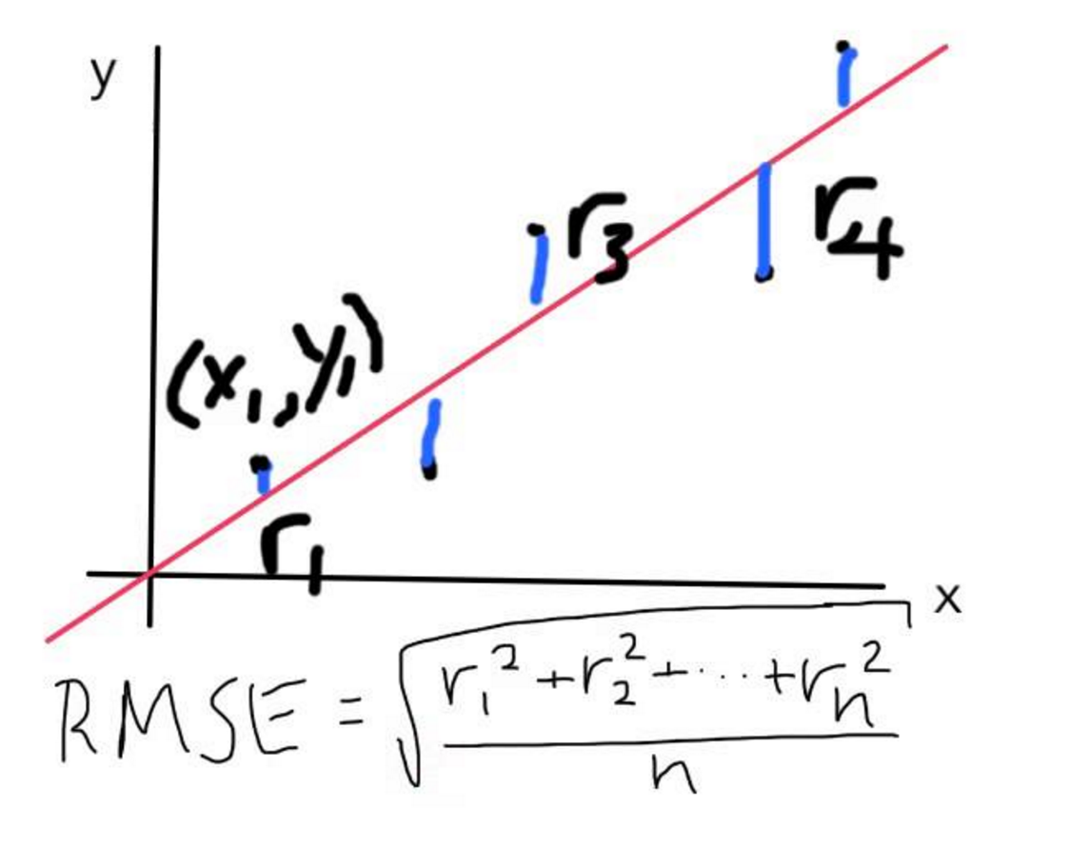
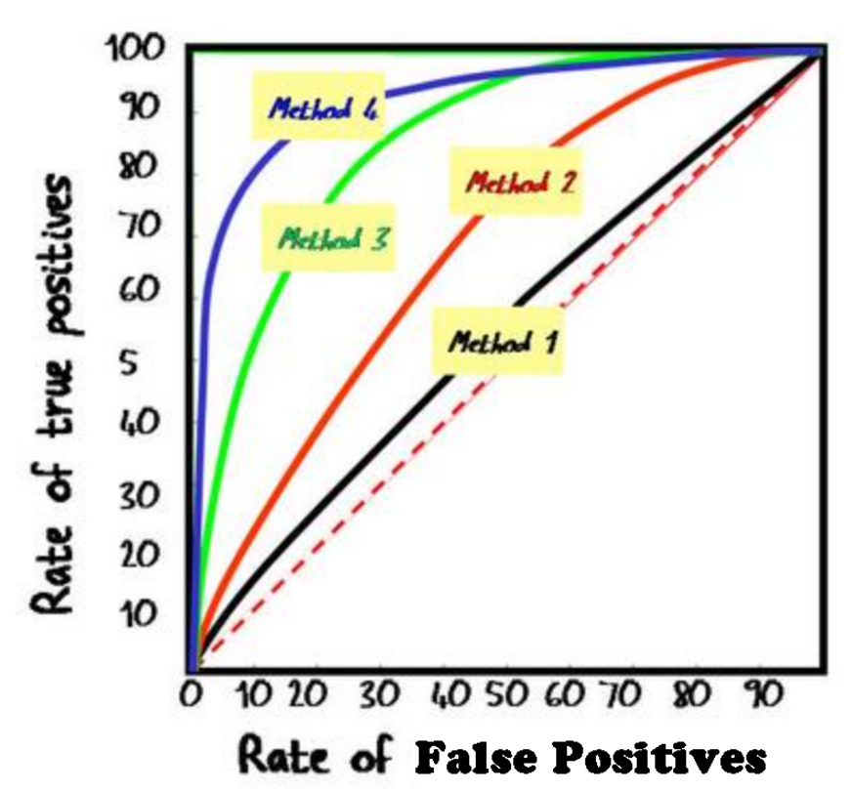

Metrics:
Balanced Accuracy
ROC Area
Data
Metrics
Protocol
Baseline
Doc
Rules
Platform
Task
Publicity
Testing

Slide 20
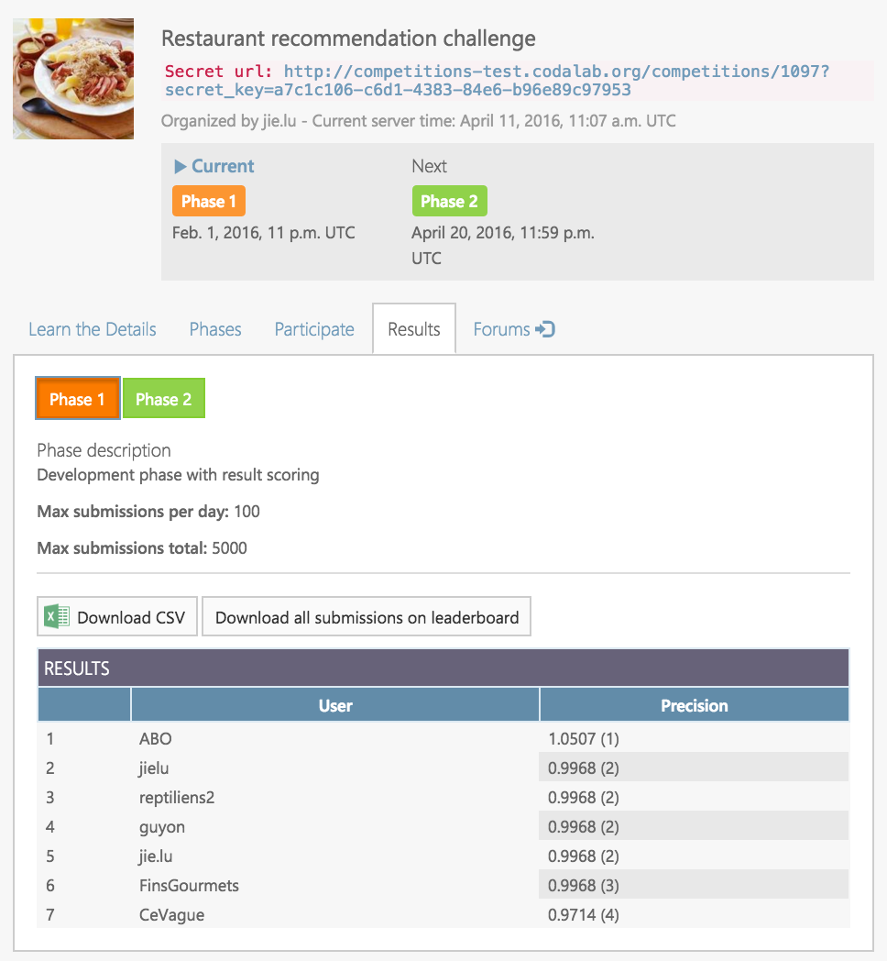
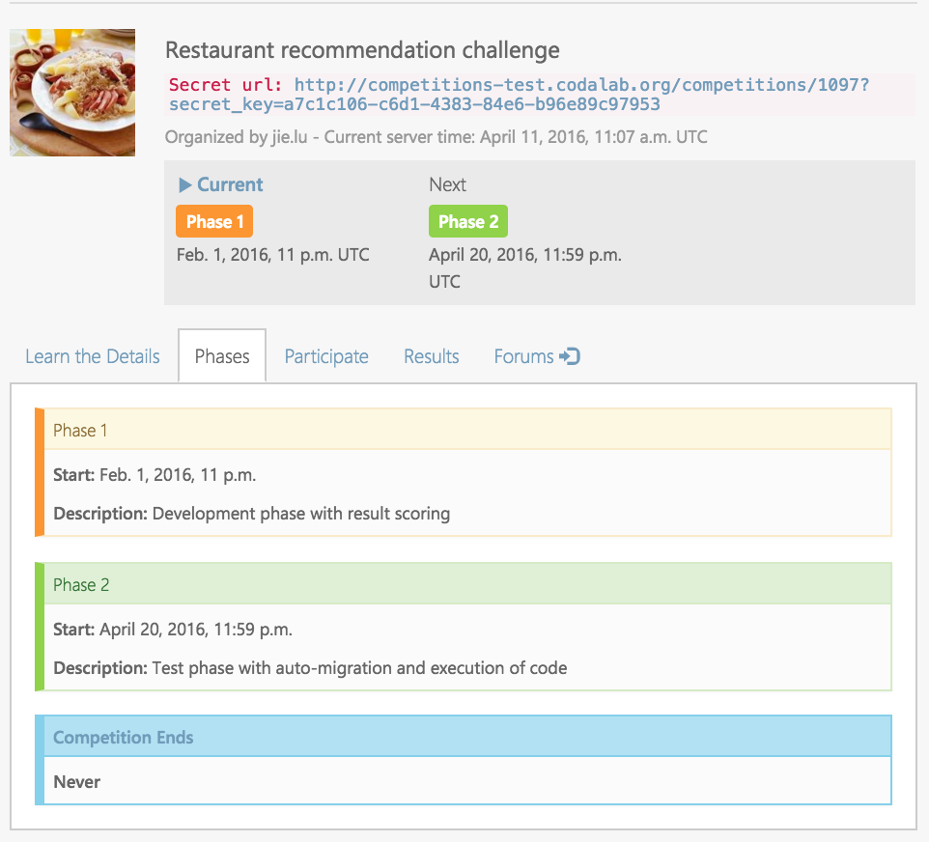

Protocol:
Data
Metrics
Protocol
Baseline
Doc
Rules
Platform
Task
Publicity
Testing

Slide 21
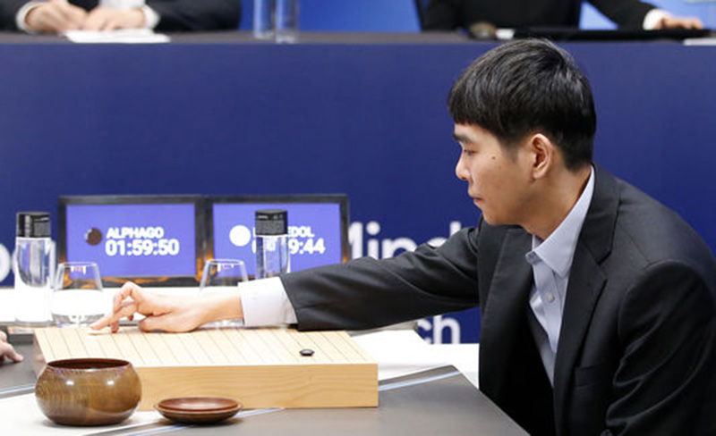
AlphaGo (Google DeepMind, 2015)
Le nombre de combinaisons à explorer est estimé à 10¹⁷⁰
ALPHAGO GAGNE 4 MANCHES À 1 CONTRE LEE SEDOL
un joueur Sud Coreen professionel 9eme dan.

Slide 22



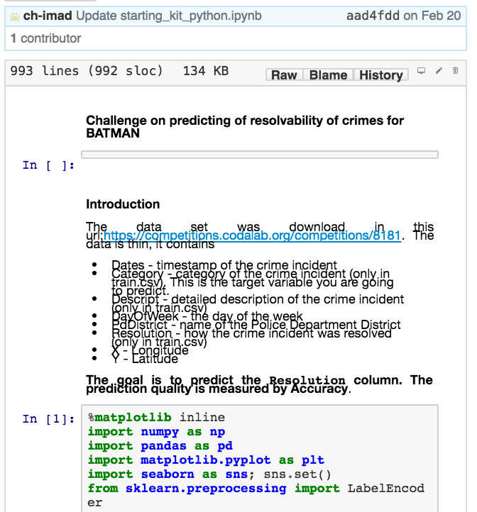
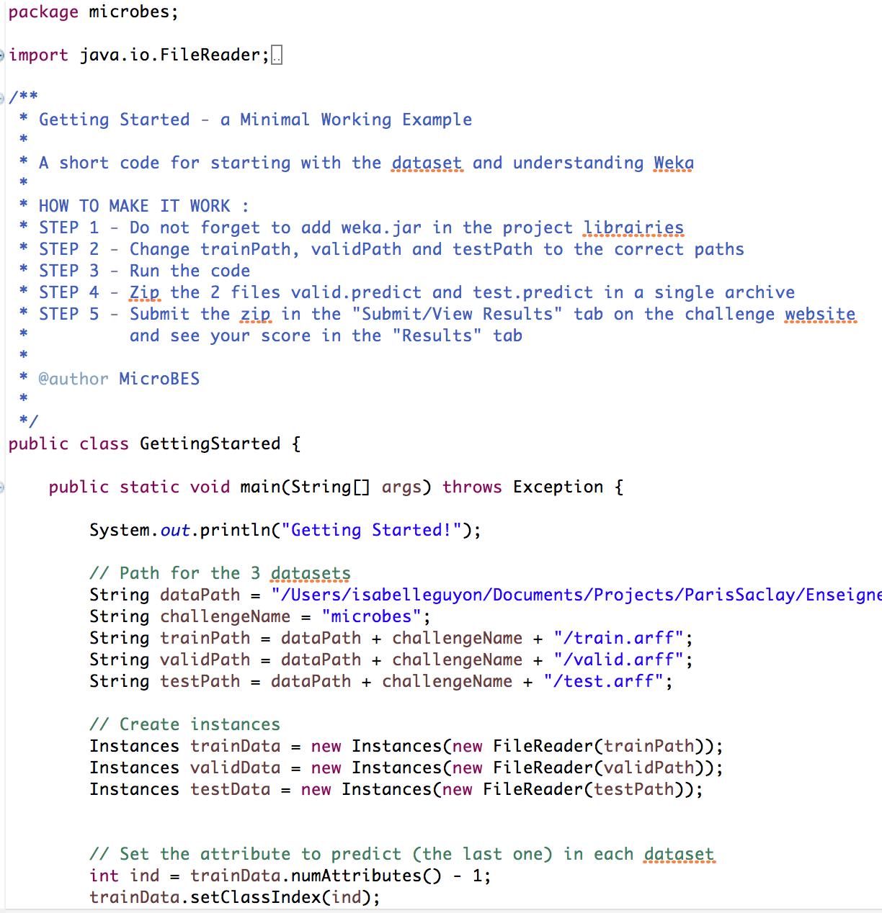
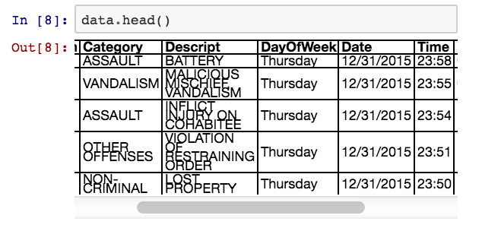
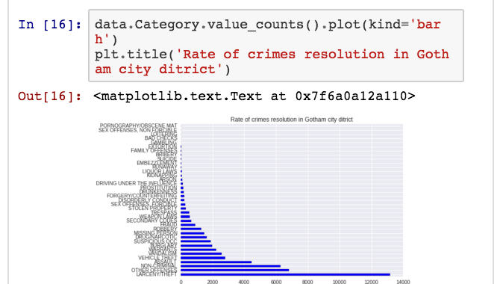
Starting kit:
Data
Metrics
Protocol
Baseline
Doc
Rules
Platform
Task
Publicity
Testing

Slide 23
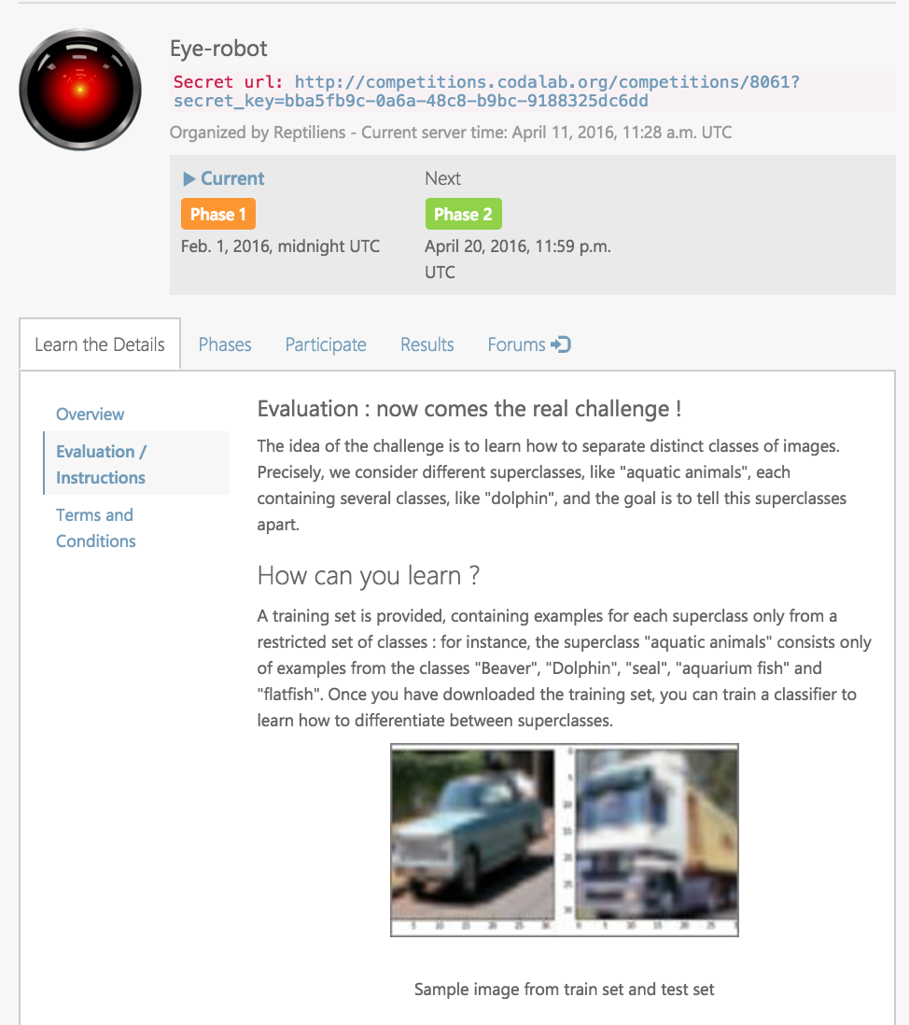
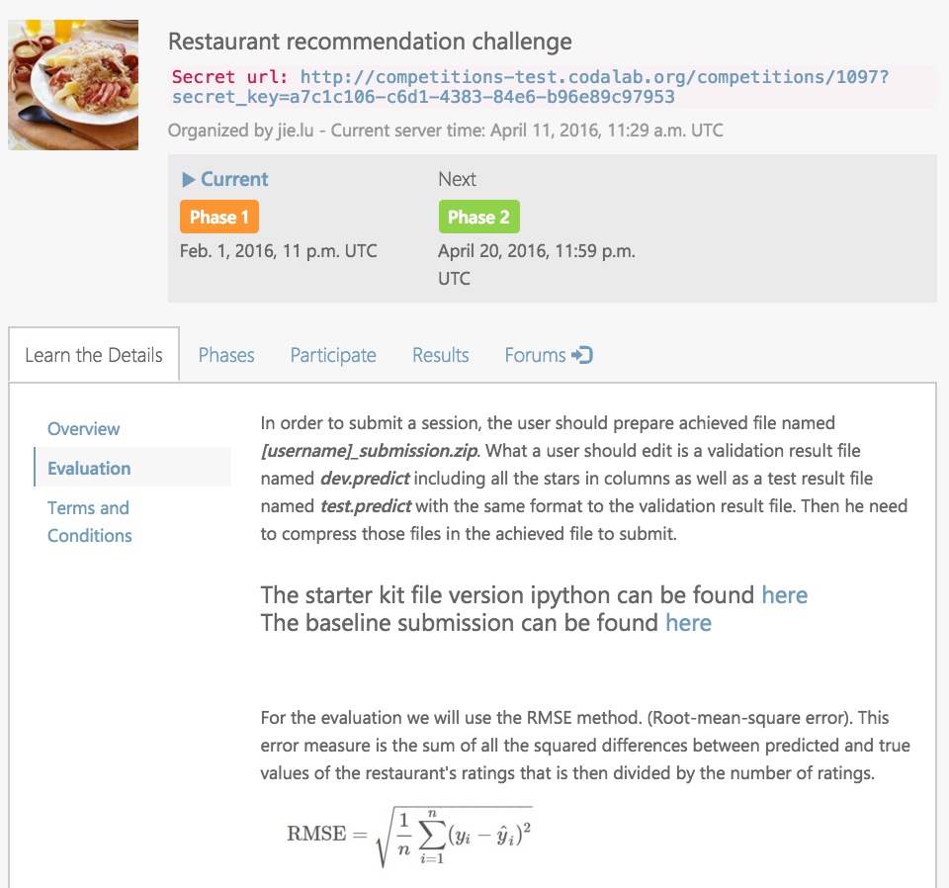
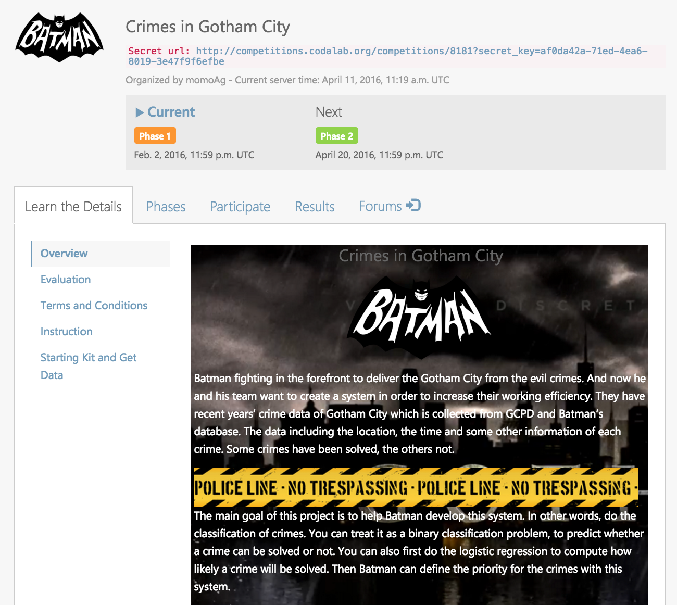
Document:
Data
Metrics
Protocol
Baseline
Doc
Rules
Platform
Task
Publicity
Testing

Slide 24
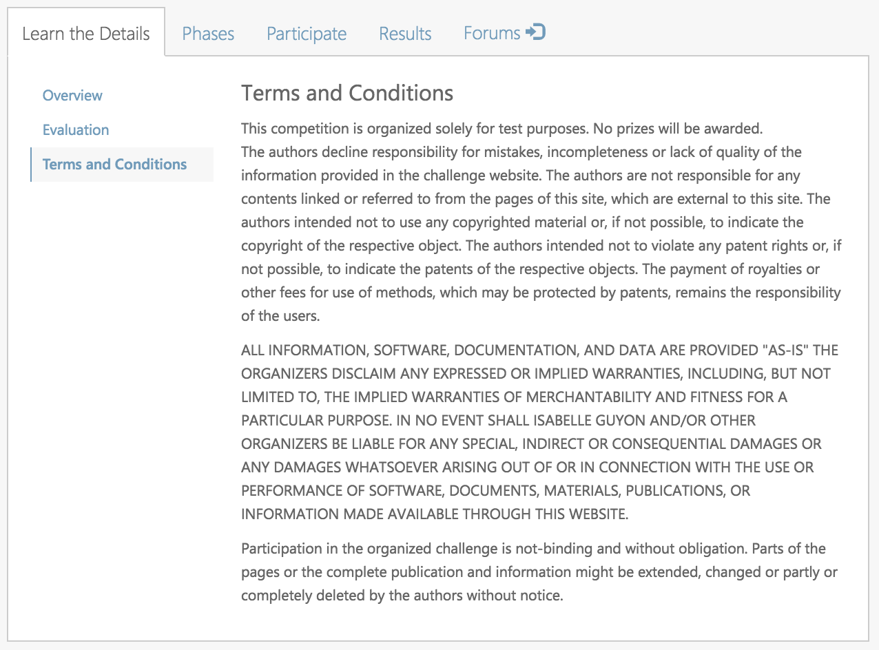
Simple rules:
One Codalab ID per team.
No more than 5 submissions per day.
Bundle your code with your results.
Submit results on validation and test set.
Auto-migration to final phase.
Deadline April 20.
Data
Metrics
Protocol
Baseline
Doc
Rules
Platform
Task
Publicity
Testing

Slide 25
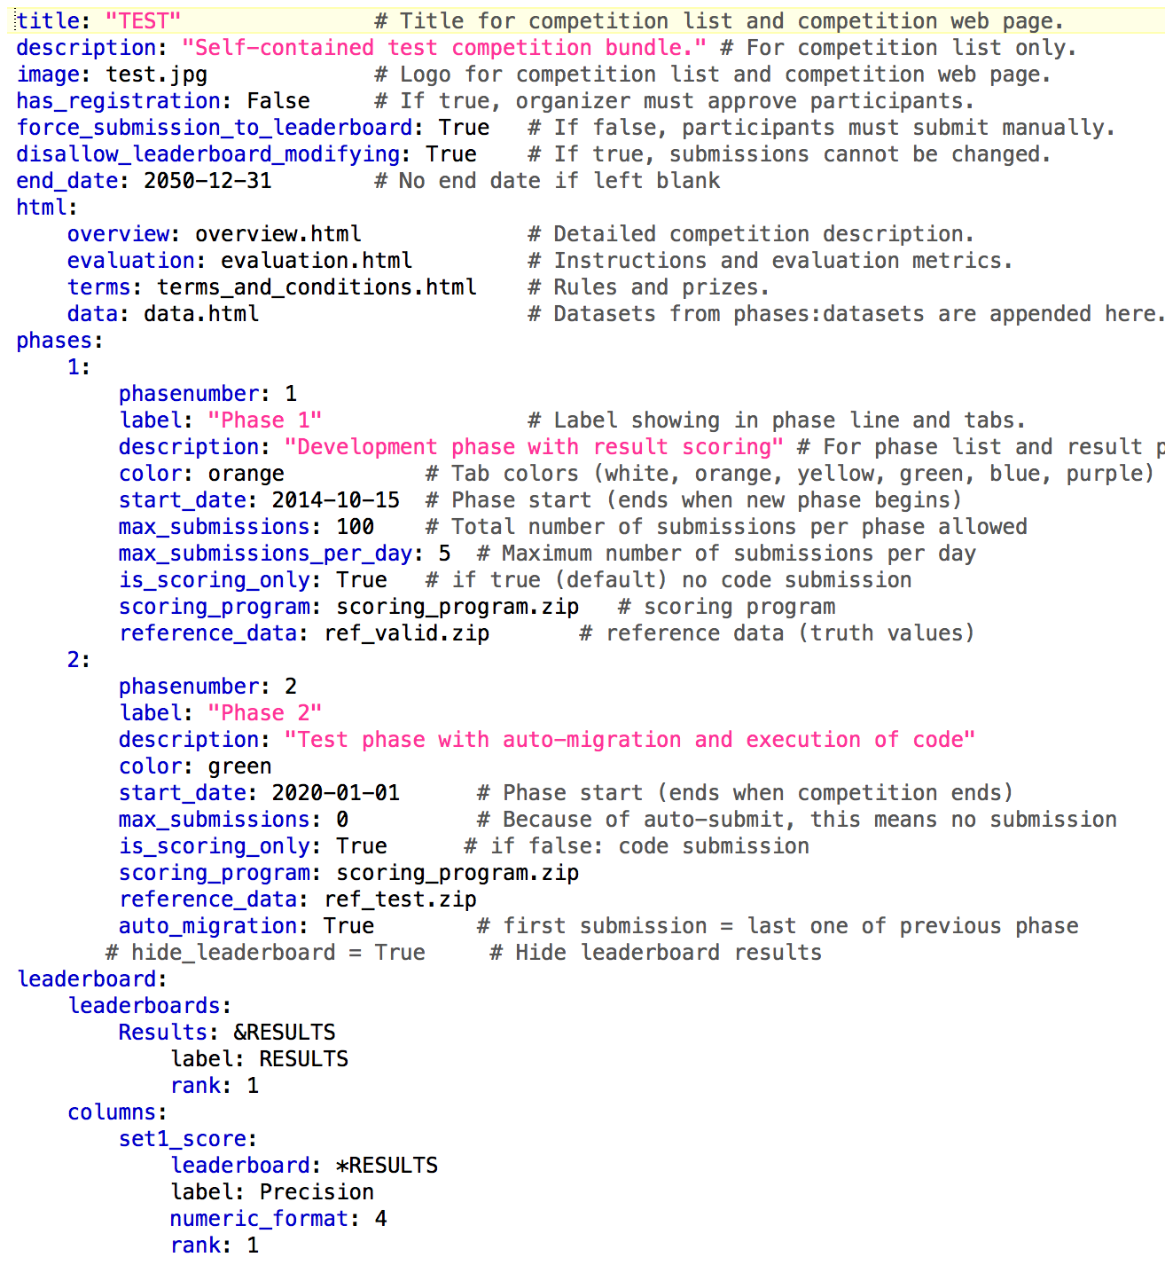
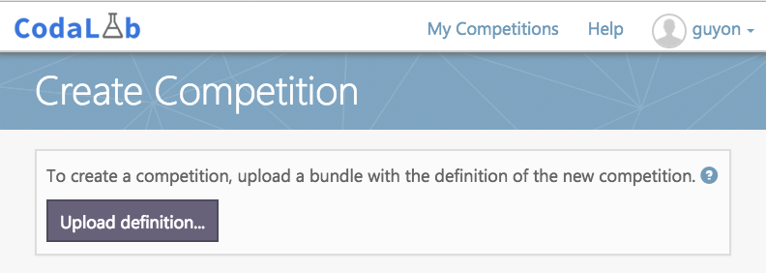
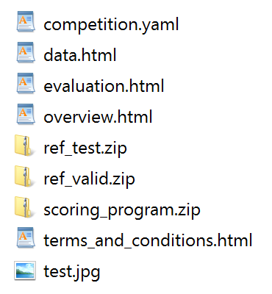

Platform:
Data
Metrics
Protocol
Baseline
Doc
Rules
Platform
Task
Publicity
Testing

Slide 26
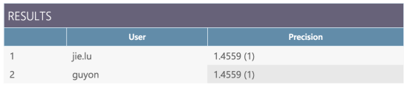
Testing:
PHASE 1
PHASE 2
VALID LABELS
ref/
ref/
TEST LABELS
submission.zip
res/
res/
Sample code
VALID PREDICT
TEST PREDICT
VALID PREDICT
TEST PREDICT
Scoring program
Scoring program
TRAIN
VALID
TEST
output/ score.txt
output/ score.txt
TRAIN LABELS
leaderboard
leaderboard
Data
Metrics
Protocol
Baseline
Doc
Rules
Platform
Task
Publicity
Testing

Slide 27



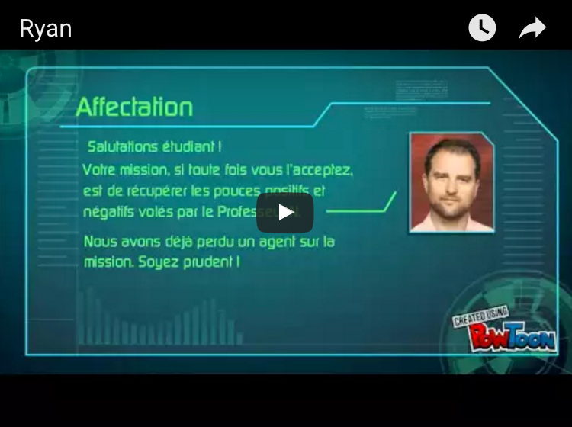
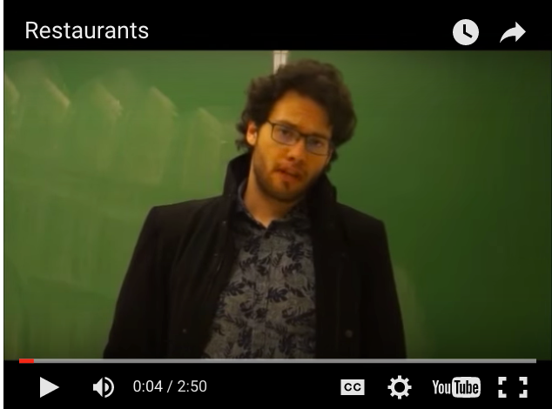
Publicity:
Data
Metrics
Protocol
Baseline
Doc
Rules
Platform
Task
Publicity
Testing

Slide 28
Conclusion:
Challenges are an efficient tool to:
- solve specific data science problems.
- attack novel research problems.
- provide practical work to students.
Want to organize a challenge?
- ask me.
- hire one of my students.
- take one of my classes.

Slide 29
Practical teaching of data science: the role of challenges Isabelle Guyon
THANK YOU

